Slide 1
M.E.S College of Engineering
Pune-411001
Department of
Electronics and Telecommunication Engineering
FE PBL 2022-23 SEM-II
Motion Sensor Security System

Slide 2
Group Members
Sneha Aghav
Manthan Sonwane
Samarth Mhamane
Drup Aherwar
Vedant Tarak
Name of the Guide:
Dr. P.N. Kota Sir

Slide 3
Project Objectives
As PIR sensor and GSM security has been used,it provides strong authentication key and security system using motion and sensor with GSM hybridization.
It can detect unwanted motion and send the notification to the user via call or SMS.
It is a security device that is installed in building to measure and detect motion in area mostly used in motion detector and security alarms with automatic lightning applications.

Slide 4
In many door security system,GSM is used for communication purpose.The purpose of a work cultivated by utilisation of a circuits like a GSM module which gets activated by a controlledr for sending SMS in emergency to proprietory and for break in. For detecting obstacles,the systems requires sensors. It gathers data from the sensors and settled on a choice.With the help of GSM module, sends SMS to a respective number.

Slide 5
Literature Survey
Presently every newspaper we may find different kind of theft happened in different places around the world. if any of the bank door opened by unknown person theif the alarm will ring to protect the bank property the bank property from theif and will send a message to user or device connect.
HIGHLY COMPONENTS PVT.LTD. engaged in the manufacturing of sensors and switches for security alarm system, magnetic door contacts, magnetic security switches and host of other sensor and accessories for security alarm systems.HAMILTON ELECTRONICS PVT.LTD. which is the leading company in the field of security related products in India'.The Company has achieved an unrivaled position in the market by introducing PIR Motion Sensor for automatic control of lights apart from others security sensors.

Slide 6
Nowadays people wants to be secure though they are away from home so, the work proposed by jayashri Bengali. When the owner is not at his home, security of home and important things is the issue in front of all two frameworks were created which depends on GSM based technology. For detection of gate-crashes, it takes place by capturing image through web cameras. When the people are not at their homes, this system sends notification in terms of SMS to the crisis number. A novel administrator based system can login without any strech to the system and can see guests record and listen their recorded message and also automatically lock the door using communication technology.

Slide 7
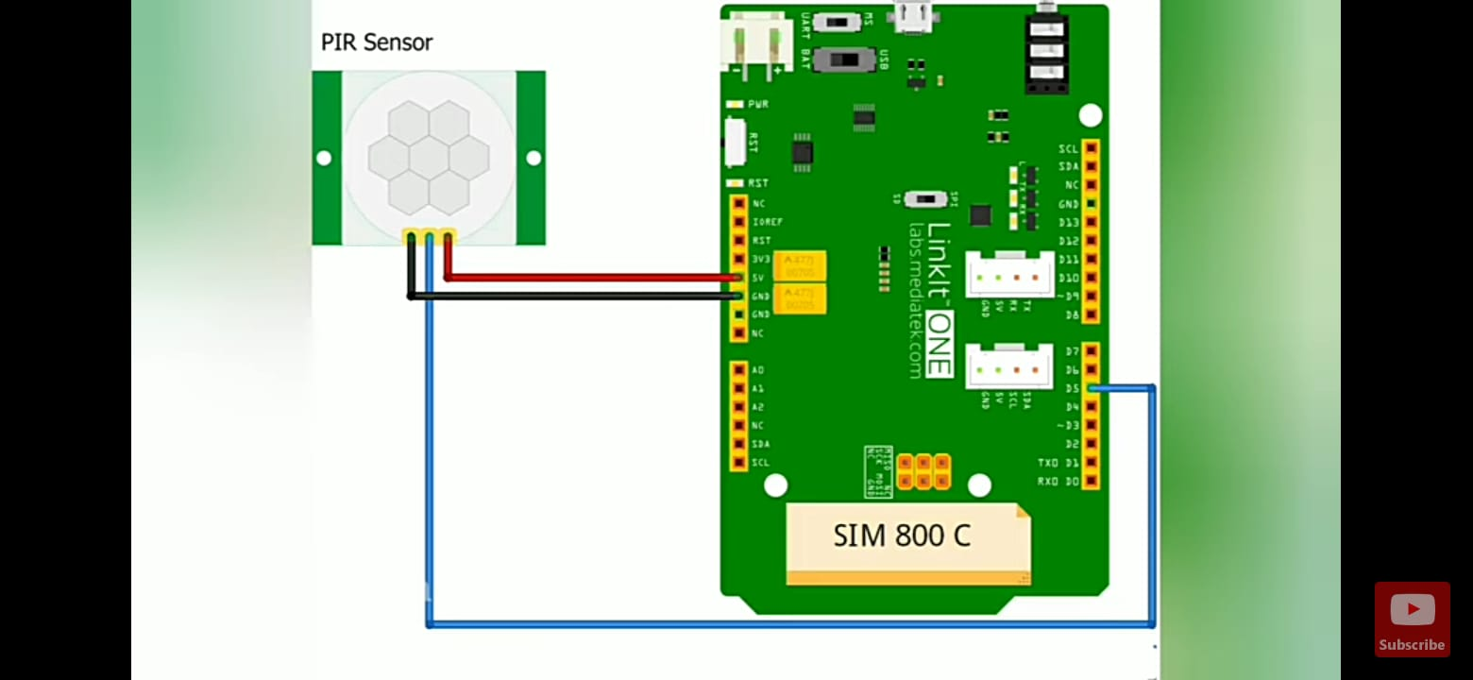
Block Diagram

Slide 8
Setup/Assembly of Components
Hardware required
PIR sensor
Arduino UNO
GSM SIM 800C
Adaptor wire
Connecting wires
Resistor
Led light
Buzzer
Software required
C++
Arduino IDLE

Slide 9
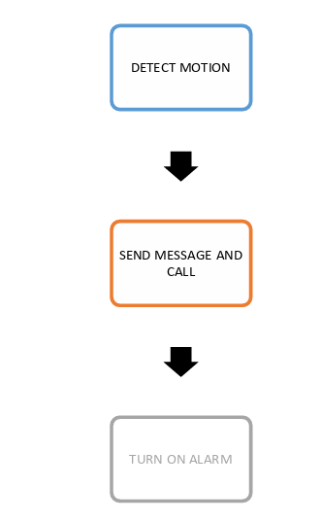
Flow Chart

Slide 10
Description
This security system consists of PIR motion sensor and GSM module and Arduino UNO as main components.
PIR sensor detects the motion where we situated this security system, as soon as motion is detected by the motion sensor message or call via will be sent on owner's phone by help of GSM module. If owner receive call then that means the motion is detected. And if owner doesn't receive call that means motion isn't caused by owner so theft alarm will turn on.

Slide 11
SMS/GOBAL SYESTEM MOBILE COMMUNICATION based security purposes are a properly choice such as a wireless connection. SMS/GOBAL SYESTEM MOBILE COMMUNICATION based protection functions are a good alternative such as a wi-fi connection. The fundamental thought of our task affords GSMbased protection, the owner will be away from the confined area. So we concluded that these applied sciences are very clever for domestic security, which human beings are satisfied whilst going to their home... For this reason, we have received wireless transmission modes via GSM., due to the fact we have our venture chosen due to the fact it is a budget friendly solution in contrast to different strategies. we are very familiar with GOBAL SYESTEM MOBILE COMMUNICATION science and are effortlessly available. Protection measures are an imperative way to defend our residences from illegal bases.

Slide 12
Advantages and Disadvantages
Advantages
Simple and easy to implement.
It can be used in various security systems like museum security, home security etc.
Time saving.
Easy to setup.
Setup doesn't occupy much space.
Disadvantages
Quiet expensive.
It can be only used for security purposes.
Poor network can cause issues like sending or receiving the call/messages on-time.

Slide 13
Applications
In museums to protect stuffs.
Also used in automatic door bell system to ring the bell when a human is detected.
Used in toys that automatically produces sound.
To protect the lockers in bank from robbery.
Banking sector and ATM.
School treasury or in locker rooms of school.

Slide 14
Conclusion
Overall, We have designed and implement a system using Arduino and a passive infrared ray sensor,which is portable,cost-effective.and highly effective as well. Such alarmsystems are hugely in demand for security purpose and thus the given system can be proved useful and effective because of the above features, A GSM based system security alert has been successfully constructed with very cheap and locally available passive and active electronic components. This device is simple to build,easy to maintain and very portable. The device can go a long wayto solving/reducing the crime rates as it can effectively contact the system owners,even when far away from system.

Slide 15
Future Scope
This' PIR sensor motion detection alarm market 'report offers details on the size, scope and potential of the industry.
The PIR motion sensor market is expected to grow annually by 8.9% (CAGR 2023-2030).
It also a system that designed to add a future attachment that makes adequate to the user by implementing the control and monitoring of security system.
As the time goes it can be provided with control of the device using our voice commands and can be used for research that could adopt additional security and algorithms.

Slide 16
Refrences
www.elprocus.com/
www.circuitdigest.com/
www.hackearth.com/
World journal of Advance and research reviews paper.
Journal of Engineering Research and Applications by Sagar Palsadkar and prof. S B patil.
GSM based home security system using PIR sensor research paper by Dr. M. Shamsul Alam.
A review paper on smart home security by Dr. Anjana Goen.

Slide 17
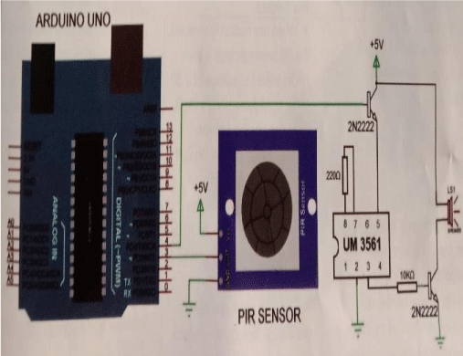
Project Difficulties
Confusion with the GSM programming.
Issues with the installation of components.
Errors with GSM calling/receiving.
Issues with GSM shield external power supply.

Slide 18
Project demonstration or presentation went pretty good and result was a fine working GSM alarm based on PIR sensor prototype.

Slide 19
“Electronics is clearly the Winner of the day.”
- John Ford

Slide 20
Thanks!

